Slide 1
Quiz Society
Week 2

Slide 2
Rules
Get into teams of 1-4 people
Have a piece of paper, a writing implement, and a team name prepared
There will be 5 rounds, with 6 questions per round
3 minutes per round
The team with the most points at the end wins

Slide 3
ROUND 1
PEOPLE
FROM THEIR GREATEST ACHIEVEMENT

Slide 4
NAME THE PERSON, WHEN GIVEN THEIR GREATEST ACHIEVEMENT
PAINTED CEILING OF THE SISTINE CHAPEL
WON THE NOBEL PRIZE FOR CHEMISTRY IN 1911.
SCORING THE WINNING PENALTY IN THE 2012 CHAMPIONS LEAGUE FINAL
MADE THE SONG ‘OLD TOWN ROAD’
SAYING “HOW YOU DOIN?”
INVENTED THE SEED DRILL IN 1701

Slide 5
ROUND 2
REAL
OR CAKE

Slide 6

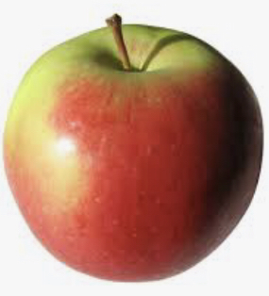
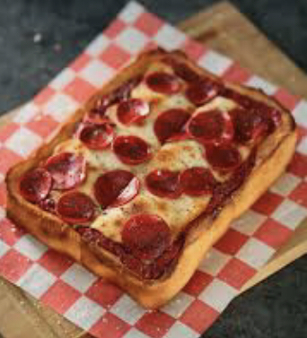
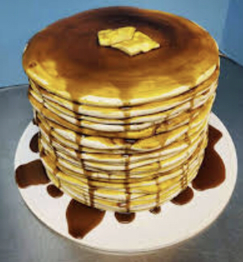
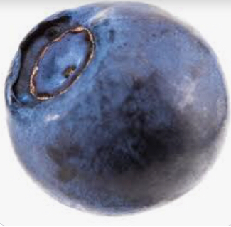
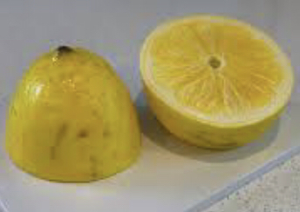
NAMES THE ONES THAT ARE CAKE
2.
4.
6.
1.
3.
5.

Slide 7
ROUND 3
MUSIC
IN THE 1960s

Slide 8
NAME THE BAND OR MUSICIAN FROM THEIR SONG
(I CAN’T GET NO) SATISFACTION
HEY JUDE
COME TOGETHER
SWEET CAROLINE
FINGERTIPS
GOOD VIBRATIONS

Slide 9
ROUND 4
CITIES
BY ANAGRAMS

Slide 10
YOU HAVE 1MIN AND 30 SECONDS
RAPID
ROUND

Slide 11
NAME THE CITIES FROM THEIR ANAGRAMS
DIAGNOSE
MORE
HASTEN
RID HAY
BARE BINS
IN VANE

Slide 12
ROUND 5
SPORTING VENUES
SPORT

Slide 13
NAME THE SPORT PLAYED IN THE SPORTING VENUE
MURRAYFIELD
ROLAND GARROS
LORD’S
ALEXANDRA PALACE
CARNOUSTIE
MGM GRAND HOTEL

Slide 14
SWAP YOUR PAPERS, IT’S ANSWER TIME
BONUS ROUND

Slide 15
MISSING LINK

Slide 16
WHAT’S THE LINK?
1.BLADE RUNNER
2.SECRET LIFE OF PETS
3.THE FORCE AWAKENS
4.PARANOIA

Slide 17
SWAP YOUR PAPERS, IT’S ANSWER TIME

Slide 18
ROUND 1
MICHELANGELO
MARIE CURIE
DIDIER DROGBA
LIL NAS X
JOEY TRIBBIANI
JETHRO TULL

Slide 19
ROUND 2
REAL
CAKE
CAKE
2.
4.
6.
REAL
CAKE
REAL
1.
3.
5.

Slide 20
ROUND 3
THE ROLLING STONES
THE BEATLES
THE BEATLES
NEIL DIAMOND
STEVIE WONDER
THE BEACH BOYS

Slide 21
ROUND 4
SAN DIEGO
ROME
ATHENS
RIYADH
BRISBANE
VIENNA

Slide 22
ROUND 5
RUGBY
TENNIS
CRICKET
DARTS
GOLF
BOXING

Slide 23
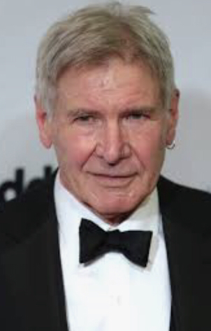
THE LINK IS “HARRISON FORD”
THEY’RE ALL HARRISON FORD FILMS

Slide 24
COUNT UP THE MARKS
RETURN THE PAPERS TO THEIR ORIGINAL TEAMS
ALL TEAMS REPORT YOUR SCORES
WAIT PATIENTLY WHILE A WINNER IS DECIDED
REVEL IN JOY IF YOU WIN

Slide 25
THE TOP 3 TEAMS MAY EACH SELECT A CATEGORY FOR NEXT WEEK’S QUIZ
A CATEGORY CANNOT BE SELECTED WITHIN TWO WEEKS OF IT BEING USED
AS FOR EVERYBODY ELSE, THANK YOU FOR COMING ALONG

